Slide 1
Developmental Biology
Jenn Soukup

Slide 2
Developmental Biology
the study of the process by which organisms grow and develop.
genetic control of cell growth
differentiation
"morphogenesis"
which is the process that gives rise to tissues, organs and anatomy.
Body plan development controlled by large networks of regulatory genes (GRNs)

Slide 3
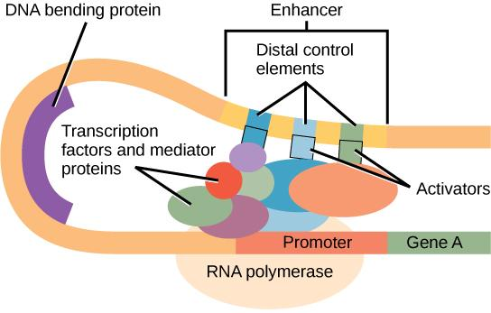

Slide 4
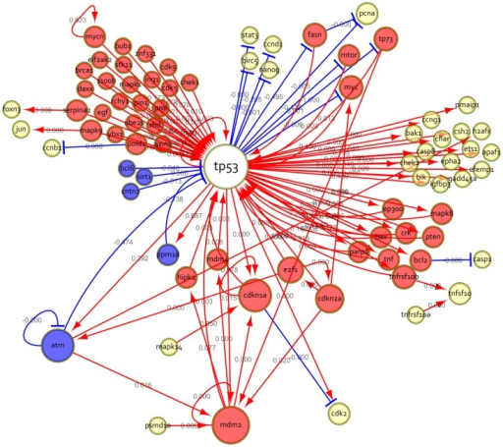

Slide 5
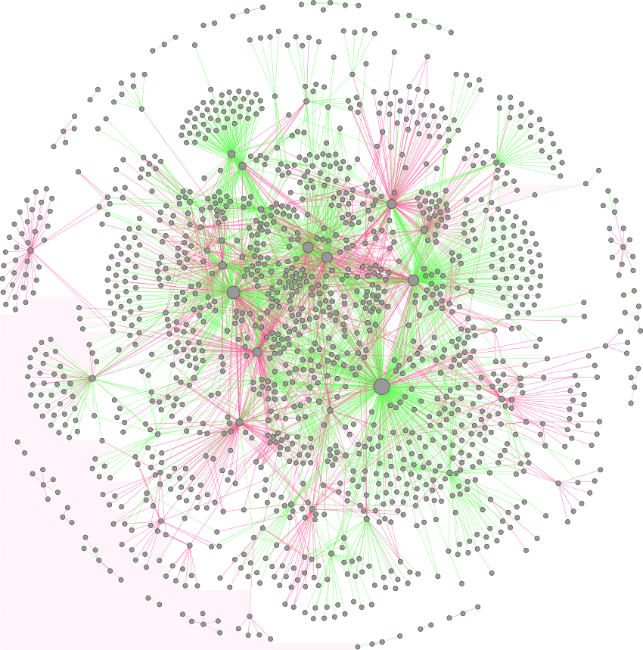

Slide 6
Outline
What are GRNs
How do they control development?
Deep conservation
Evolutionary modification of GRNs
Network Origination
Reading GRNs

Slide 7
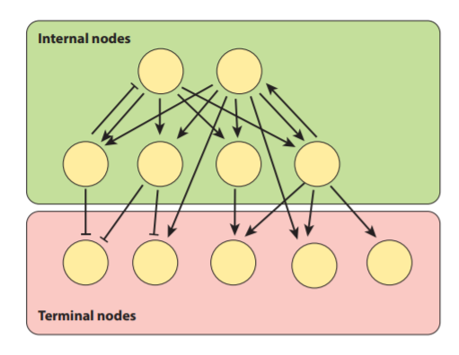
What are GRNs?
GRNs drive development through differential expression
Connected by cis-regulatory apparatus
** Internal nodes: can control the expression of other genes
** Terminal nodes: influence final cell type differentiation
Notes:
Cis-regulatory apparatus binds the transcription factors of the network to activate the zone of interest
Internal: a gene within GRN that can control the expression of other genes. Often encode transcription factors and members of signaling pathways
Terminal: no role in regulating expression, determines final cell type differentiation
Abstract of GRN
Yellow circles represent genes
Activating other genes == arrows
Represses other genes == horizontal bar

Slide 8
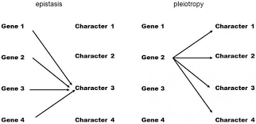
Interactions within GRNs
Epistatic interactions - the interaction of genes, in particular the suppression of the effect of one such gene by another
Pleiotropic - having multiple, independent functions; regulatory genes frequently affect the expression of multiple other genes at multiple times and places and are therefore pleiotropic
Notes:
E codes for color
e is no color ----> yellow
B is dominate produces black
b is recessive and produces brown
Epistasis is the phenomenon where the effect of one gene (locus) is dependent on the presence of one or more 'modifier genes', i.e. the genetic background

Slide 9
Interactions in GRNs
Polygenic - single phenotype controls by multiple genes and usually has an additive effect
ie. skin pigmentation
Phenotype
Notes:
E codes for color
e is no color ----> yellow
B is dominate produces black
b is recessive and produces brown
Epistasis is the phenomenon where the effect of one gene (locus) is dependent on the presence of one or more 'modifier genes', i.e. the genetic background

Slide 10
Interactions in GRNs
Epistatic interactions - the interaction of genes, in particular the suppression of the effect of one such gene by another
i.e. labs and coat color
Notes:
E codes for color
e is no color ----> yellow
B is dominate produces black
b is recessive and produces brown
Epistasis is the phenomenon where the effect of one gene (locus) is dependent on the presence of one or more 'modifier genes', i.e. the genetic background

Slide 11
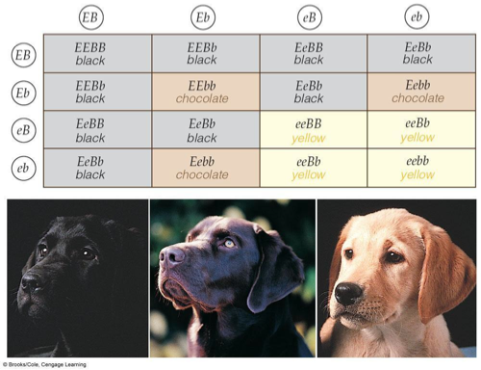
Notes:
E codes for color
e is no color ----> yellow
B is dominate produces black
b is recessive and produces brown
Epistasis is the phenomenon where the effect of one gene (locus) is dependent on the presence of one or more 'modifier genes', i.e. the genetic background

Slide 12
Epistasis and Pleiotropy
Pleiotropic - having multiple, independent functions; regulatory genes frequently affect the expression of multiple other genes at multiple times and places and are therefore pleiotropic
i.e. melatonin
Phenotype
Phenotype

Slide 13
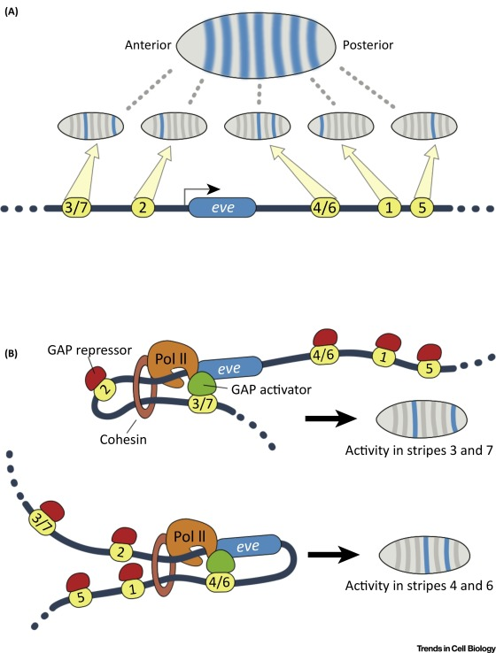
How do GRNs control development?
Enhancers: DNA sequence where transcription factors bind to regulate the expression of a target gene
Expression pattern dictated by spatial distribution of the transcription factors
Combinatorial logic - multiple transcription factors bind and each has an input
gene is only expressed where input patterns overlap
Example of enhancer: eve gene
Notes:
Enhancers - short lengths of DNA to which particular transcription factors bind to
Work as a committee to activate target enhancer sequences and drive expression of subordinate genes of the network
Eve gene
Encodes a transcription factor that is expressed as seven stripes - setting up segmented zones of the embryo
Stripe 2 enhancer contains binding sites for spatially restricted activators and repressors that combine and generate a discrete pattern
Each module (which codes for 1 or 2 stripes) requires the docking of multiple transcription factors allowing them to act independently or exhibit modularity: the action of one enhancer is assumed to not interfere with the function of another non-overlapping module

Slide 14
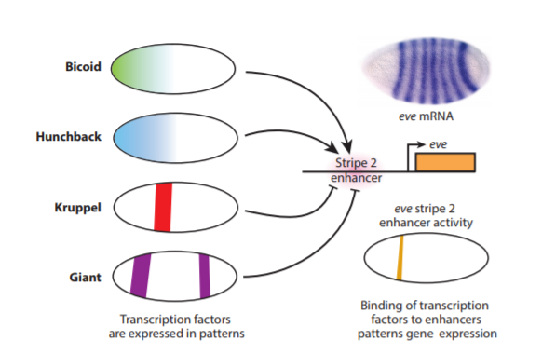
How do GRNs control development?
Combinatorial logic - multiple transcription factors bind and each has an input
gene is only expressed where input patterns overlap
Example of enhancer: eve gene
Notes:
Enhancers - short lengths of DNA to which particular transcription factors bind to
Work as a committee to activate target enhancer sequences and drive expression of subordinate genes of the network
Eve gene
Encodes a transcription factor that is expressed as seven stripes - setting up segmented zones of the embryo
Stripe 2 enhancer contains binding sites for spatially restricted activators and repressors that combine and generate a discrete pattern
Each module (which codes for 1 or 2 stripes) requires the docking of multiple transcription factors allowing them to act independently or exhibit modularity: the action of one enhancer is assumed to not interfere with the function of another non-overlapping module

Slide 15
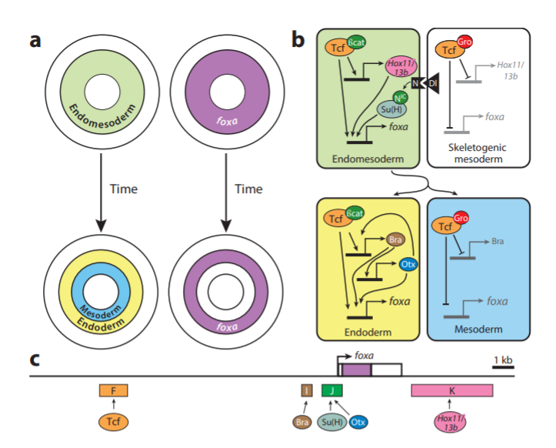
Dynamic Regulation
Notes:
Tcf-B-catenin complex, Notch effector suppressor of Hairless, and homeobox factor Hox11/13b initiate foxa expression
Signals from adjacent micromeres function to clear the nuclear B-catenin from the innermost tier of endomesoderm cells --- Groucho repressor is recruited is inhibits the foxa expression.
Each module has a particular function, but together control expression by interacting with the basal promoter in combination

Slide 16
Test for Network Hierarchy
Genetic test
Expression is measured in a background for which the regulating gene is manipulated
DNA-binding assay
Measures the mobility of a DNA probe to determine if a transcription factor binds to a particular sequence
Gel eletrophoretic mobility shift
Chromatin immunoprecipitation
Determine transcription factor occupancy on regulatory DNA
Reporter assay mutation
Introducing a mutation to disrupt the binding of a afctor
Pros
Cons
Notes:
Indirect - factor activates one or more downstream genes that ultimately regulate the gene in question
Direct - factor in question binds to the enhancer of the downstream gene
Determine if relationship in a network is direct - must demonstrate the direct binding of a factor to the target regulatory sequence
Done through chromatin immunoprecipitation and gel shift assay
Complimented with a reporter assay
Pro: Considered the gold standard for making direct connections
Con: Labor intensive Con: Need model species

Slide 17
Developmental Evolution and GRNs
How do new phenotypes manifest through the alteration of networks?
How do new networks arise?
Every mutation occurs in a GRN
Early development requires specific patterned expression
Mutations in cis-regulatory or enhancers
Resulting in few pleiotropic effects
Deep conservation of network components
Modifications to existing networks
Origins of networks that create new structures with no obvious precursor

Slide 18
Conservation
Core set of conserved transcription factors
The major classes of transcription factor are highly conserved
“developmental toolkit”
builds the internal nodes of GRNs
Hox gene clusters
Notes:
Core set of conserved transcription factors
sit at the end of signaling pathways make signal-regulated decisions at enhancers
The major classes of transcription factor are highly conserved
“developmental toolkit” that builds the internal nodes of GRNs is deeply conserved in sequence.

Slide 19
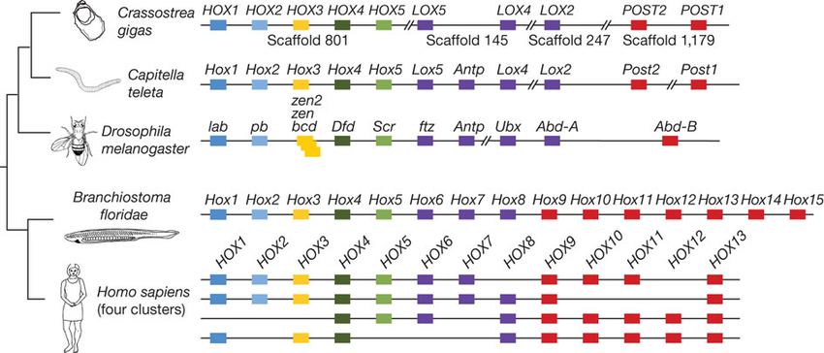
Hox Genes
Notes:
Hox transcription factors pattern body axial identity
Organized into gene clusters in a very similar way across bilaterians,
Rosetta Stone of animal pattern formation

Slide 20
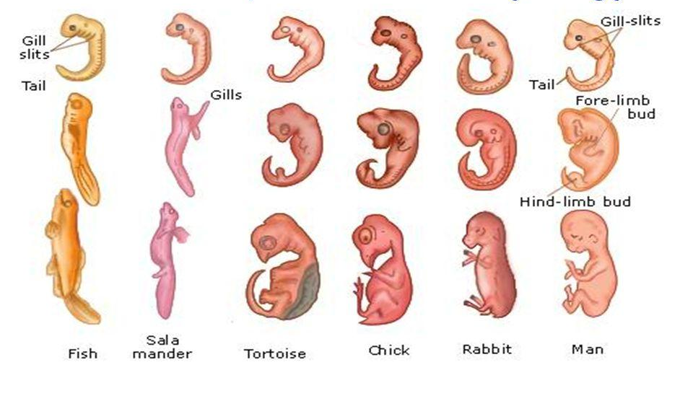

Slide 21
Conservation
Pax6/Eyeless transcription factor
eye formation
Brain-patterning proneural transcription
neuronal development
Implications for the evolution of GRNs
When a key role for a transcription factor evolves, it is often preserved.
Transcription factors maintain conserved roles, their DNA-binding specificities tend to evolve slowly or maintain ancestral functionality
Connections between regulatory factors remain conserved within GRNs.
Notes:
Pax6/Eyeless transcription factor important for vertebrate and invertebrate eye formation
Brain-patterning proneural transcription factors required for neuronal development across metazoa
These parallels have several implications for the evolution of GRNs:
When a key role for a transcription factor evolves, it is often preserved.
Second, since transcription factors maintain conserved roles in GRNs, their DNA-binding specificities tend to evolve slowly or maintain ancestral functionality.
Finally, the deep conservation of transcription factor collections in certain developmental processes suggests that connections between regulatory factors often remain conserved within GRNs.

Slide 22
GRN Subcircuit Conservation
Sea urchins and sea stars (diverged ~400 mya)
Portions of the network (subcircuits) are highly similar
Subcircuit of four factors: Gata4/5/6, Otx, Blimp1, and Foxa
Subcircuit of four factors (direct mesoderm specification)
Heart Specification Network
NK-2 transcription factor (Drosophila and vertebrates)
MEF2 transcription factor
Ancestral role in muscle cell specification, used during the evolution of the heart
Vertebrate GATA4/5
Drosophila Pannier factors
Heart/endomesoderm GRNs similarities
Once established, the loss of these connections would be developmentally catastrophic
Dubbed as “subcircuits kernels”
Part of a computer’s operating system crucial to the machine’s function that operates in a protected memory space.
Notes:
Certain portions of the network (subcircuits) are indeed quite similar despite of the long span of time over which such linkages must have been maintained
For example, subcircuit composed of four transcription factors (Gata4/5/6, Otx, Blimp1, and Foxa) is highly similar in both taxa, as is another subcircuit of four factors that direct mesoderm specification
Studies of the GRN for the heart show an even deeper ancestry of conservation in network topology
The NK-2 transcription factor—encoded by a gene named tinman in Drosophila, because of the lack of a heart in these mutants—shares a key position in the heart specification network of Drosophila and vertebrates
MEF2 transcription factor has an ancestral role in the specification of muscle cell identity, a role that was employed during the evolution of the heart
The vertebrate GATA4/5 and the homologous Drosophila Pannier factors also serve similar roles in these networks.
Similarities in heart and endomesoderm GRNs,
arose 500 and 700 million years ago, respectively
Once these connections were established, their loss would be developmentally catastrophic, and thus highly unlikely
Dubbed as subcircuits kernels, an analogy to the part of a computer’s operating system that is so crucial to the machine’s function that it operates in a protected memory space.

Slide 23
Transcription Factor Conservation
Network component connections sometimes remain unchanged at the level of the DNA sequences that bind individual transcription factors.
Nervous system GRN connections
between the Notch signaling pathway, effectors of the Hairy/Enhancer of Split (HES) transcription factor family, and the proneural transcription factors that specify neuronal fates
binding site for the Notch-regulated HES factors is present in human and fly proneural genes of both the atonal and achaete-scute gene families
Transcription factor binding sites in human SoxB2 gene locus noncoding region
Present in cnidarian Nematostella vectensis, zebrafish, sea urchin, and Drosophila
Drives reporter expression in the nervous system for each organisms

Slide 24
Mutations

Slide 25
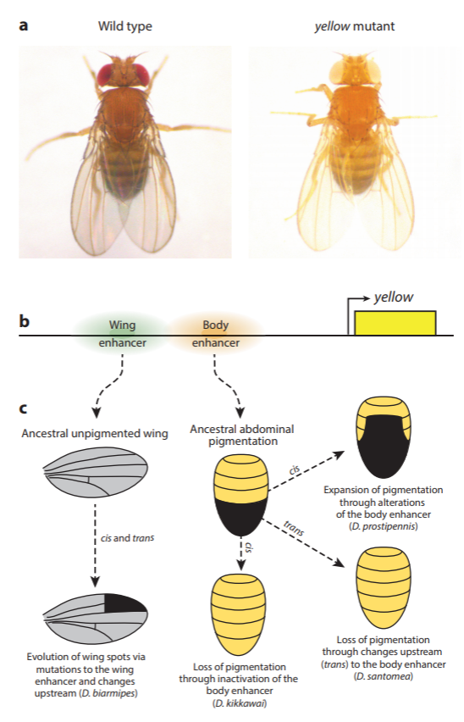
Modification of GRNs
Differences in gene expression:
Mutations to the regulatory apparatus of the gene (a cis change)
Alterations in upstream regulators (a trans change)
Compare the activities of the given regulatory regions in a reporter assay within a common genetic background
Cis: differences in expression are recapitulated by the enhancer sequences
Trans: changes result in an absent or poor recapitulation of the species-specific expression pattern.
Notes:
Cis regulatory elements: regions of non-coding DNA which regulate the transcription of neighboring genes
Trans-regulatory elements: genes which regulate the expression of distant genes; DNA sequences that encode transcription factors.

Slide 26
Modification of GRNs
GRN evolution pigment patterns of Drosophila
Model system
1,500 species
Ample variation in pigment patterning
Pigment system “yellow” is well-studied
Lightening of pigmentation on abdomens, bristles, and wings
Wing/abdomen: two separable enhancers in the gene’s upstream regulatory region
Notes:
Cis regulatory elements: regions of non-coding DNA which regulate the transcription of neighboring genes
Trans-regulatory elements: genes which regulate the expression of distant genes; DNA sequences that encode transcription factors.

Slide 27
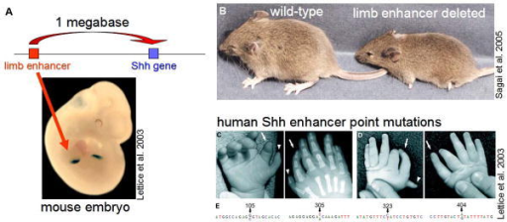
Mutation in Enhancers
Notes:
Mutation in mice that affected limb enhancer to make legs. Mutated mouse has truncated limbs.

Slide 28
Altering the Trans-regulatory Landscape
Changes in higher tiers in GRN results in ripples
Simplest type: modification to the expression pattern or timing of a transcription factor.
Examples:
Loss of armor plates/spines in sticklebacks
Loss of trichomes in Drosophila larvae
Diversification of wing spots
Butterfly mimicry (Heliconius butterflies)
Lots variation
Small number of loci play a substantial role in wing pattern variation
Changes in the cis-regulatory apparatus of the same trans regulators present in the butterfly wing
Three regions control the bulk of color-pattern variation
D locus causes changes in red color patterns in subspecies of H. melpomene and H. erato
Sd locus controls the size, position, and shape of forewing color bands by changing black regions of the wings
Notes:
Terminal node: changes to node function (or expression) result in a minimally modified GRN that differs only at the state of the gene that was changed.

Slide 29
Modify Transcription Factors at Protein-Coding level
GRN evolutionary variation associated with enhancers
Though to be the result of modularity
Transcription factors can be modular
Can also mutate to reduce pleiotropy
Gene rearrangement processes shuffle domains to produce variations in the types and numbers
New domains:
can independently direct new GRN functions, leaving original functions intact
execute functions in specific spatio-temporal contexts if they facilitate binding of an interacting partner that is restricted in expression
Transcription factors have a primary and secondary preference position weight matrix (PWM)
Single DNA-binding domain can evolve preferences for alternative DNA-binding motifs without altering preferences for their ancestral primary motif.
Notes:
Position weight matrix (PWM): a matrix of a transcription factor’s binding specificity based on multiple sequences known to bind the factor
New domains can independently direct new GRN functions, leaving original functions intact
Transcription factors acquired new transactivation domains, appears to be linked to the evolution of vertebrate-specific characters
New domains may execute functions in specific spatio-temporal contexts if they facilitate binding of an interacting partner that is restricted in expression
Evolution of the placenta
HoxA11 (usually represses expression of pregnancy-related genes)
HoxA11 acquired the ability to bind the FoxO1a transcription factor. In endometrial stromal cells, which express FoxO1a, HoxA11 interacts to activate rather than repress pregnancy-related genes.
Context-dependent splicing (particular times and places in the embryo)
doublesex gene in Drosophila
differentially spliced in males and females
splice forms differently regulate downstream genes to direct sex-specific GRNs.
Transcription factors have a primary and secondary preference PWM
Tbox transcription factors from mouse, sea urchin, and sea star share similar primary PWM but different secondary PWM.
Single DNA-binding domain can evolve preferences for alternative DNA-binding motifs without altering preferences for their ancestral primary motif.

Slide 30
Network Origination
How do completely new structures that have no obvious precursor originate?
Beetle horns
GRN co-option
the redeployment of an existing network to evolve a new structure
New morphological structures
new and unique expression patterns of ancestral genes rather than from the evolution of new genes.
Ancestral genes are usually transcription factors and signaling pathway ligands
are predicted to alter many subordinate genes in their respective networks.

Slide 31
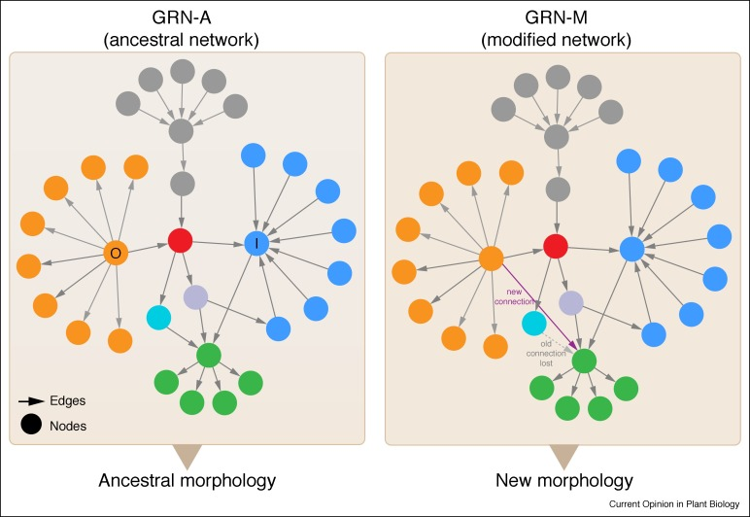

Slide 32
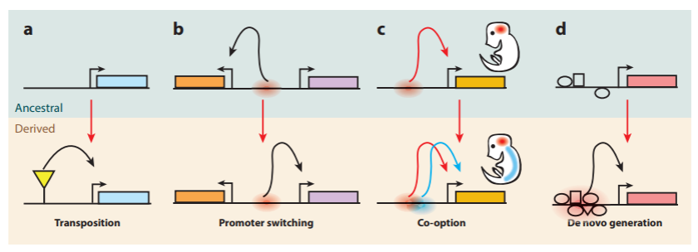
Creation of Nodes
Trans-regulatory modification
Preexisting enhancer is activated in a new location where upstream regulators have been deployed in new tissue.
Transposable elements (TEs) in the origination of enhancer sequences
Two-thirds of the human genome is composed of repetitive sequences derived from transposons

Slide 33
Creation of Nodes
Altered enhancer-promoter specificity
Pitfall of promoter-switching is pleiotropy; where the interaction with a new promoter may alter the ancestral pattern of the original target gene of the enhancer.
Reuse or co-option of individual ancestral enhancers
Enhancers may evolve from nonfunctional sequences that contain chance binding sites

Slide 34
Summary
GRNs lie at the heart of animal development
Most transcription factor families and developmental signaling pathways are conserved
For many organ systems, GRNs have a deep metazoan ancestry
Alteration of transcriptional regulatory sequences (cis-regulatory evolution) is a commonly observed in morphological evolution
Many mechanisms exist to modify transcription factor function at the coding sequence level
Many human adaptations are thought to arise from cis-regulatory evolution
Co-option (reuse) of preexisting GRNs underlies the generation of new structures
There are several mechanisms that exist for the deployment of genes into new tissues
Notes:
Gene regulatory networks lie at the heart of animal development by controlling which subset of the genome is activated in time and space to generate a tissue’s physical properties
With some individual transcription factor binding sites remaining conserved for hundreds of millions of years
Modifies the pattern and level of gene expression
There is mounting evidence for this mechanism has accumulated in several case studies
Which may dictate a GRNs resulting shape and topology

Slide 35
Illustrating GRNs
Traditional approaches have focused on determining the functions of one or a few genes at a time
Cis-regulatory elements receives multiple inputs
inputs are transcription factors, which contain specific target site sequences

Slide 36
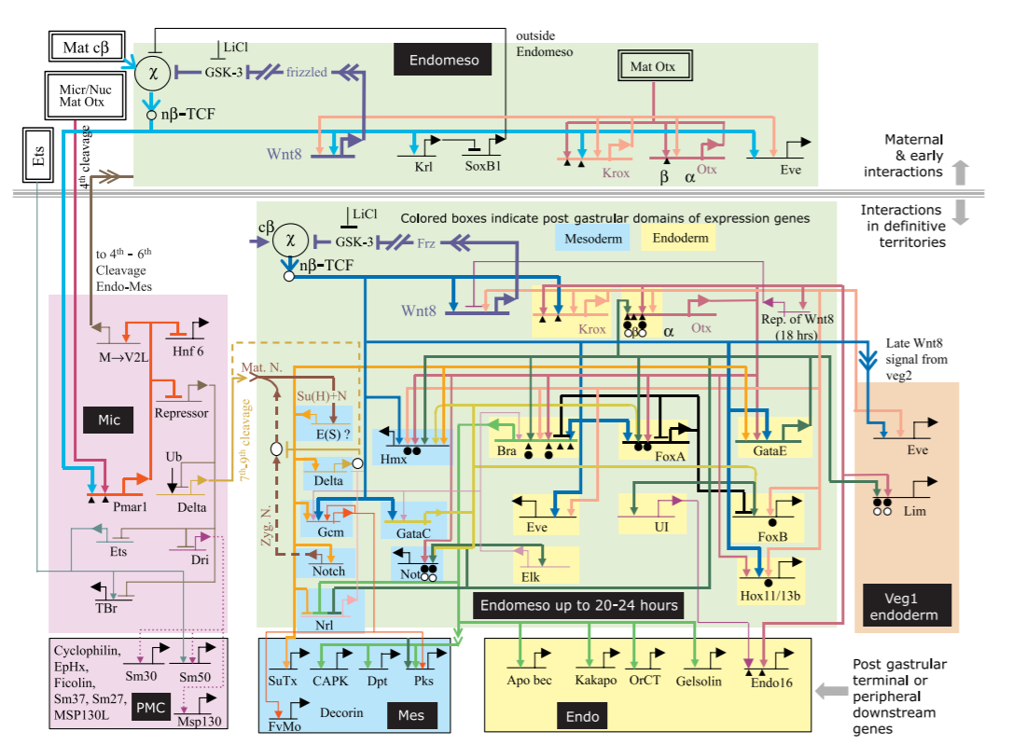
Reading GRNs
Notes:
How to read the network
Mother provides proteins that influences phenotypic variation (almost like nature vs nurture, where the environment (nature) provided by the mother changes the outcome).
Everything starts off general but then starts to differentiate and delegate.

Slide 37
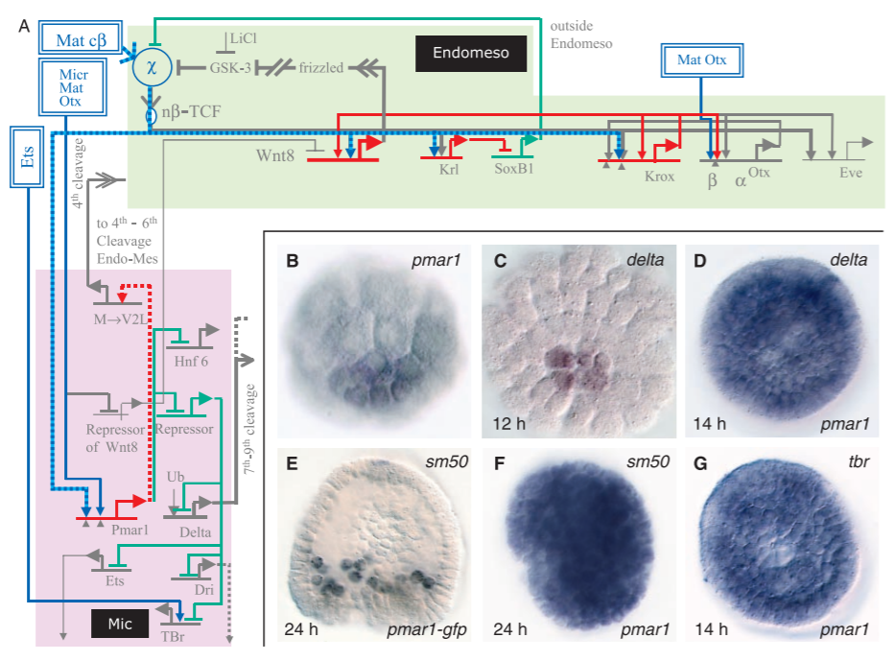
Reading GRNs
Notes:
How to read the network
Mother provides proteins that influences phenotypic variation (almost like nature vs nurture, where the environment (nature) provided by the mother changes the outcome).
Everything starts off general but then starts to differentiate and delegate.

Slide 38
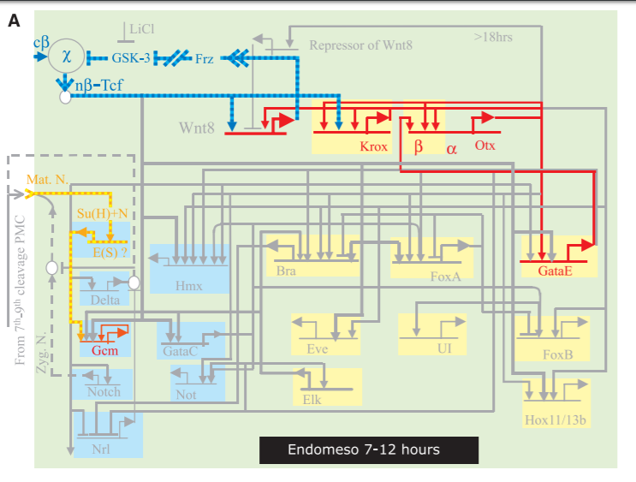
Reading GRNs
Notes:
How to read the network
Mother provides proteins that influences phenotypic variation (almost like nature vs nurture, where the environment (nature) provided by the mother changes the outcome).
Everything starts off general but then starts to differentiate and delegate.

Slide 39
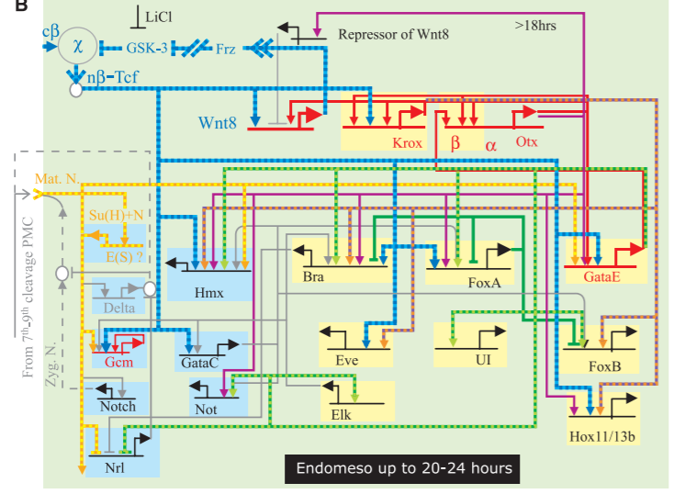
Reading GRNs
Notes:
How to read the network
Mother provides proteins that influences phenotypic variation (almost like nature vs nurture, where the environment (nature) provided by the mother changes the outcome).
Everything starts off general but then starts to differentiate and delegate.

Slide 40
Reading GRNs
Notes:
How to read the network
Mother provides proteins that influences phenotypic variation (almost like nature vs nurture, where the environment (nature) provided by the mother changes the outcome).
Everything starts off general but then starts to differentiate and delegate.

Slide 41
Questions?

